Slide 1
Integrated Healthcare Waste Management Approach for Sustainability
From Planning to Implementation
Dhundi Raj Pathak, PhD
Independent Solid Waste Management Specialist/Geo-environmental Engineer

Slide 2
Things to Be Considered for ISWM-From Planning to Implementation
Current collect and dump approach in municipalities of Nepal needs to be changed to ISWM with maximum resource recovery however the primary objective of HCWM is to protect public health and the environment,
All HCFs are legally and financially responsible for treating infectious waste themselves to minimize risks of infections/disease transmissions,
All the HCW once treated, can be sent to municipal waste management system for further management including resource recovery and final disposal in close coordination/collaboration with local government,
Baseline data (e.g. waste generation and composition) are essential for design of ISWM system including technology selection, capacity assessment and budgeting

Slide 3
Essential Steps in Integrated Waste Management Planning and Implementation
Data collection
Problems identification & need assessment
Selection of financially & environmentally appropriate ISWM Option
Identification strategic areas of and drafting long-term strategic SWM objectives
Setting long-term vision, targets, planning period & guiding principles
Identification of waste management alternative options and prioritization of waste management options
Drafting SWM implementation plan including activities, need budget, responsible agencies , target etc.
Implementation
Monitoring & Evaluation
Drafting SWM status report and predicting future trends
Allocation of resources (budget, human resources etc.) for sustainable ISWM

Slide 4
From Planning to Implementation: Essential Steps for ISWM– Data Generation
Data is the fuel for planning
Garbage In, Garbage Out
No data or processing of fabricated data produce no results or useless results
Waste types, generation, composition is important for design of successful waste management system including technology selection, capacity assessment and budgeting

Slide 5
From Planning to Implementation: Essential Steps for ISWM– MSW and HCW Estimates in Nepal
About 19 million municipal population in Nepal generates 5600 MT/day (0.1% of global waste generation),
Healthcare Facilities (about 40,000 beds, and other non-bedded small facilities) generate about 75 ton/day (2% of total waste in Nepal)
Only 10% to 30% (average 20%) HCW is infectious and hazardous however if mix to MSW, all waste becomes infectious
Separate collection and decontamination of infectious waste is very essential…..
293 Municipalities (19 million population
Hospitals (~ 40,000 beds (??))
Non-bedded HCFs
98% of total waste
HCW = 75 ton/day (60 from bedded HCF @ 1.5kg/bed/day + 20% from non-bedded facilities = 15 ton/day)
2% of total waste
MSW ~ 5600 ton/day
~80 % general waste like MSW
10 % - 30% (Average 20%) infectious/hazardous waste
Total Solid waste ~ 5675 ton/day

Slide 6
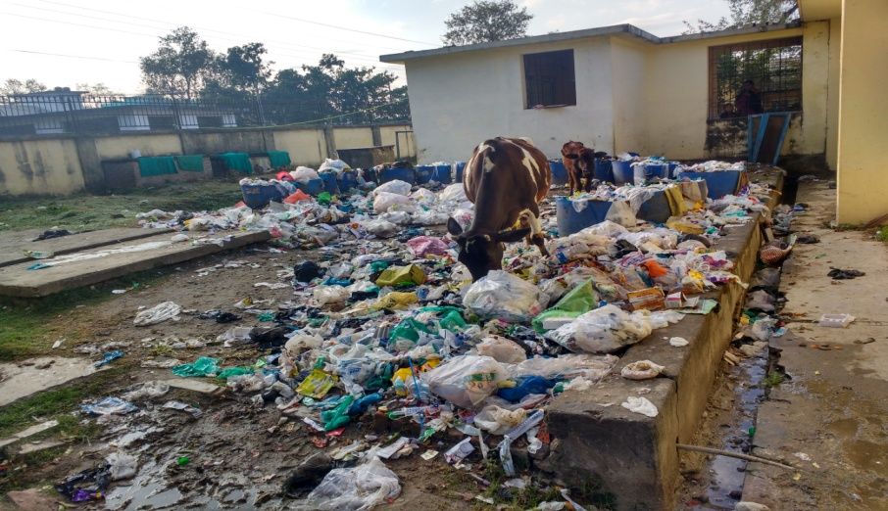
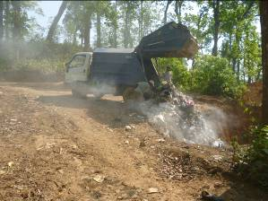
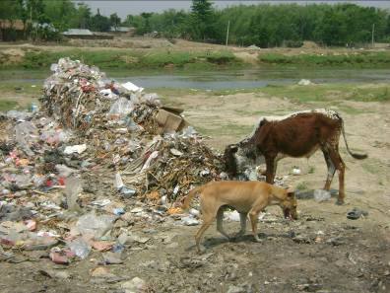
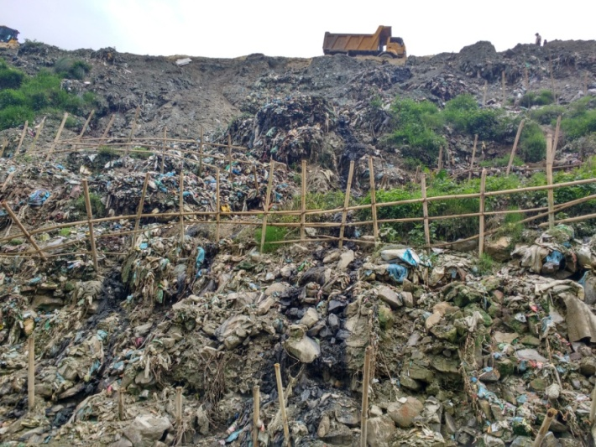
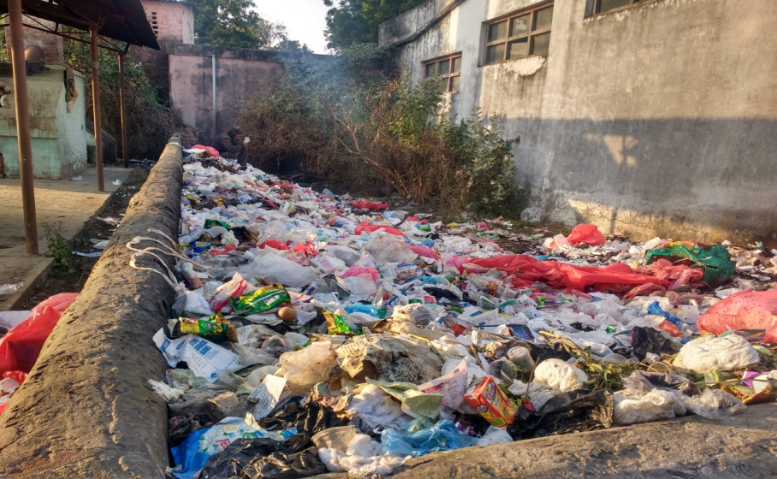
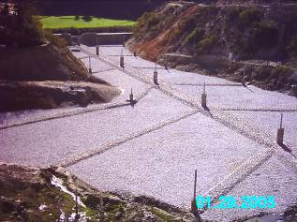
From Planning to Implementation: Essential Steps for ISWM – Problems Identification
Inaruwa municipality
Dumping of infectious HCW in Hospital backyard
Dumping of Waste in Rivers
Sisdole landfill site (??) – Semi-aerobic sanitary LFS in early days, now converted to dump site
12/11/2019
IHCWM Approach for Sustainability: From Planning to Implementation – D. R. Pathak
6

Slide 7
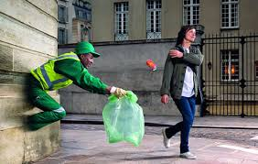
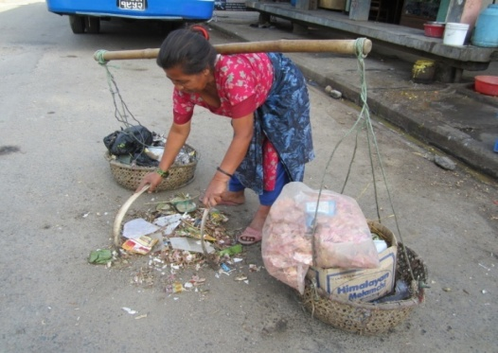
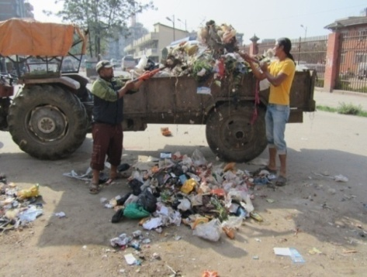
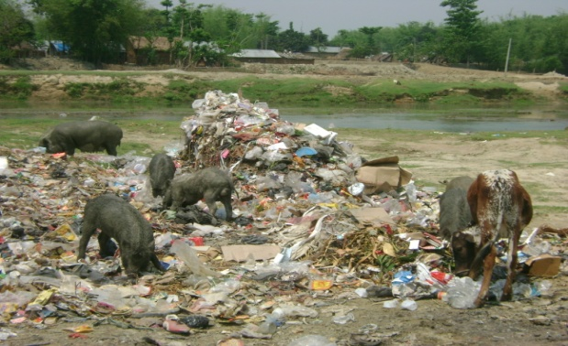
From Planning to Implementation: Essential Steps for ISWM – Problems Identification and Need..
FIRST THOUGHT: WASTE is RESOURCE
Bring one bag of WASTE …Give you one bag of MONEY
SECOND THOUGHT: WASTE is WASTE
Dump somewhere but NOT IN MY BACKYARD
It’s municipality’s job..
I have paid tax so I have right to throw it..
Municipality thinks
WASTE is a major problems but no resources to manage it.
Spent huge amount for just SWEEP and DUMP (US$ 30/ton)
REALITY….
WASTE is not WASTE but RESOURCE
Can be managed it properly …
Becomes financially self-sustainable
ATTITUDE & MIS-INFORMATION ARE REAL PROBLEM!

Slide 8
From Planning to Implementation: Essential Steps for ISWM – Guiding principles, setting long-term vision, mission and Strategic Targets
Example of Strategic targets over planning period
Planning period: short-term, Mid-term and long-term
Vision
Mission
Guiding principles
Respect the aspiration of the Constitution for clean and healthy environment,
Implementation of SWM Act 2011 and Local Government Operation Act, 2017, HCWM guidelines, 2014 strictly,
Encouraging proactive participation of all stakeholders,
Duty of care principle, polluters pay, precautionary principle, proximity principle, Non-burn principle
Incentives, Rewards and Punishment,
Sustainability through Resource Recovery, Technology improvement/Scale up, Revenue Generation and Sharing

Slide 9
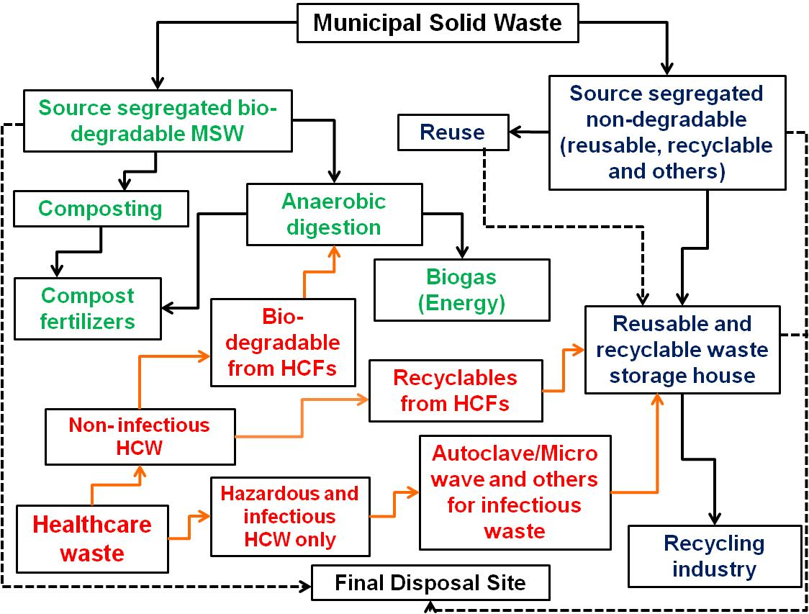
From Planning to Implementation: Essential Steps for ISWM – Integrated Municipal Waste Management including HCWM System

Slide 10
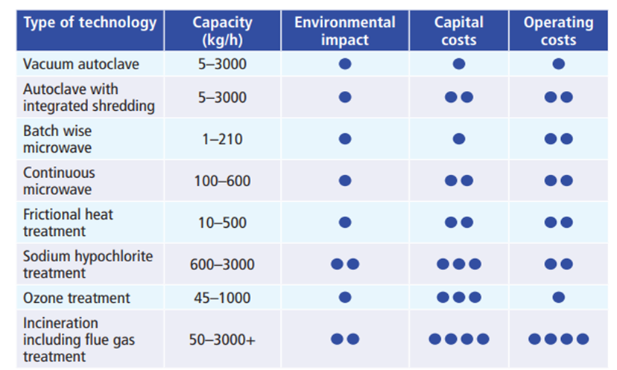
From Planning to Implementation: Essential Steps for ISWM – Basis of Technology Selection for Infectious Waste Treatment

Slide 11
From Planning to Implementation: Essential Steps for ISWM – Alternative Scenarios for Capacity Assessment of Selected Technology for HCW Treatment
Current Scenario (Status quo): with current bed number and current bed occupancy with current practices with low level of segregation (for immediate action plan);
Intermediate Scenario with current bed number at 100% bed occupancy with 50% risk waste to be treated with improved level of segregation (For mid-term plan);
Projected Scenario with projected bed number and 100% bed occupancy with risk waste to be treated after optimal segregation (long-term plan).

Slide 12
From Planning to Implementation: Essential Steps for ISWM – Example of ISWM Strategy and Implementation Plan
रणनैतिक क्षेत्र १ : संगठनात्मक तथा कानुनी संरचना (Institutional and Legal Framework)
उद्देश्य 1: नगरपालिकालाई सक्षम तथा छरितो संगठनकोरूपमा स्थापित गर्ने र स्थायी तथा दिगोरूपमा फोहर ब्यबस्थापन गर्न आबश्यक नीति, कानुन, रणनीति, कार्ययोजना, निर्देशिका, कार्यविधि आदि तयार गर्ने, स्थानीय आबश्यकता अनुसार परिमार्जन गर्ने र अद्यावधिक गर्ने (Objective 1: To enhance the municipality as an effective organization, and develop, update and enforce policies, legislation, guidelines and code of practices to encourage sustainable SWM) |  |  |  |  |  |  |  |  |  | HH=Households, M=Municipality, C= Community, T=TLO, P= Private Sector, PoG = Province Government, CoG = Central Government H=Hospital, D=Development Partners
क्र. स. | अल्पकालीनकार्ययोजना | मध्यकालीन/दीर्घकालीन कार्ययोजना | प्रक्षेपित तथ्यांक (२०१९) | लक्ष्य (%, संख्या ) |  |  | प्रस्तावितबजेट (नेरु. '000) |  |  | दायित्व (Responsibility) |  | आधारहरू
 |  |  |  | अल्पकालीन |  |  | अल्पकालीन योजनाको लागि
 |  |  |  | २०२० | २०२१ | २०२२ | २०२० | २०२१ | २०२२ | मुख्य | सहयोगी | दर (नेरु. ) | एकाई/सन्दर्भ)
१ | नगरपालिकामा फोहरमैला ब्यबस्थापन समिति गठन र सो को लागि निश्चित शाखा/उप-शाखा/एकाई स्थापना गर्ने / |  |  | 100% | 100% | 100% | 20 | 20 | 20 | M | HH, TLO, P | 20000 | Rs/Annum
उद्देश्य ४: स्वास्थ्यजन्य फोहर र विशेष हानिकारक फोहर (जस्तै, उद्योग धन्दाबाट निस्किने हानिकारक फोहर, मरेका जनावरहरु आदि) मापदण्ड अनुरूप सुरक्षित व्यवस्थापनको लागिमापदण्ड कार्यान्वयन, नियन्त्रण तथा नियमन गर्ने (Objective 4: To implement, control and regulate for safe management of healthcare waste, special and hazardous waste according to standards)
क्र. स. | अल्पकालीन कार्ययोजना | मध्यकालीन/दीर्घकालीन कार्ययोजना | प्रक्षेपित तथ्यांक (२०१९) | लक्ष्य (%, संख्या ) |  |  | प्रस्तावित बजेट (नेरु. '000) |  |  | दायित्व (Responsibility) |  | आधारहरू
 |  |  |  | अल्पकालीन |  |  | अल्पकालीन योजनाको लागि
 |  |  |  | २०२० | २०२१ | २०२२ | २०२० | २०२१ | २०२२ | मुख्य | सहयोगी | दर (नेरु. ) | एकाई/सन्दर्भ)
१ | अस्पतालजन्य फोहरको उचित व्यवस्थापनलाई अनिबार्य गराउने तथा सहजीकरण गर्ने / |  |  | 50% | 50% |  | 50 | 50 | - | H | M | 100000 | per Annum
२ | हरेक स्वास्थ्य संस्थाहरुमा फोहरमैला ब्यबस्थापन समिति गठन गर्न र साथै फोहरमैला ब्यबस्थापनको लागि प्रस्ट कार्य विवरण सहित फोहर ब्यबस्थापन अधिकृतको नियुक्तिकोलागि अनिबार्य गराउने / |  |  | 100% | 100% | 100% | 748 | 748 | 748 | H | M | 747500 | Rs/Annum (salary of waste coordinator, 1 other staffs and 15% overhead cost)

Slide 13
From Planning to Implementation: Essential Steps for ISWM – Example of Allocation of Resources for ISWM infrastructures and Operation
Type of funding sources | No | Rate (NPR/Year) | Estimated revenue (NRs. in 000), if collected from 40% HHS and other sources by the end of 2022 with 10% annual increment in charge
 |  |  | २०२० | २०२१ | २०२२
Grant received from Central Government |  |  | ० | ० | ०
Municipal budget in SWM |  |  | २००० | २००० | १०००
Households | 15,753 | १२०० | 2878 | 5112 | 8717
Hotels | १२३ | ३६०० | 66 | 116 | 195
Shops | १५०० | १२०० | 270 | 473 | 794
Industries |  | ६००० | 0 | 0 | 0
Government and non-government offices | १०० | १२०० | 18 | 32 | 53
Educaional Institutions (Schools, Colleges, training institute etc.) | ६४ | १२०० | 12 | 20 | 34
Medical (Hospitals and Clinics) | २३ | ६००० | 21 | 36 | 61
Others (Slaughter house) | १५ | ४८०० | 11 | 19 | 32
Revenue from recyclable materials (NRs./year, 000) |  | १ | 55 | 148 | 187
Revenue from comost products (NRs./year, 000) |  | १ | 17 | 25 | 43
Grant from development partners |  |  | 0 | 0 | 0
Others |  |  | 0 | 0 | 0
Total |  |  | 5347 | 7980 | 11116
Total fundfor short-term, mid-term and long-term activities |  |  | 24443

Slide 14
Key to Success
Political will/vision/confident to solve the problem of waste management
SWM should recognize as Urban Infrastructures with realistic plans and targets (Don’t consider SWM as Crisis Management)
Once ready SWM strategy and plan, early steps include extending collection to the whole city, phasing out open dumps and replacing them with controlled disposal sites,
Noted that the infectious waste first needs to be neutralized. HCW - once treated - can be sent to the municipal waste system for further recovery and management ……But Not ENOUGH
An ISWM approach should focus on resource recovery and financial sustainability (provision of SWM service fees and revenue generation)
Encouraging proactive participation of all stakeholders – PPPP (4P) Model,
Establish formal material collection and recovery system by constructing MRF in partnership with community and private sectors with improvement and scaling up of technology and providing opportunities to set up recycling industry,
Choice of Technology -Right data, realistic plan, ground reality (Think about nature of waste prior to adopt TECHNOLOGY)
Imperfect copy of WM technology may not work but CUSTOMIZE it to maximize recovery of resources – THINK GLOBALLY, DO LOCALLY
Education together with enforcement of law

Slide 15
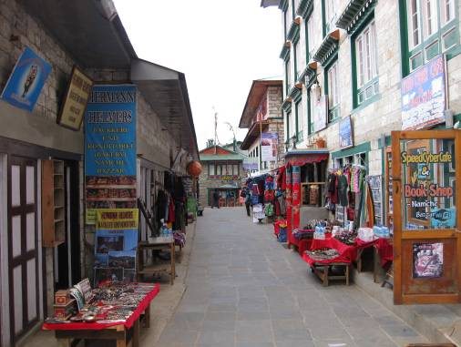
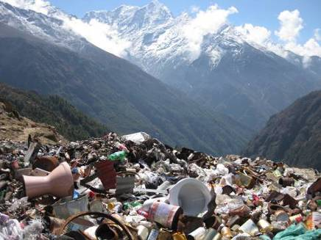
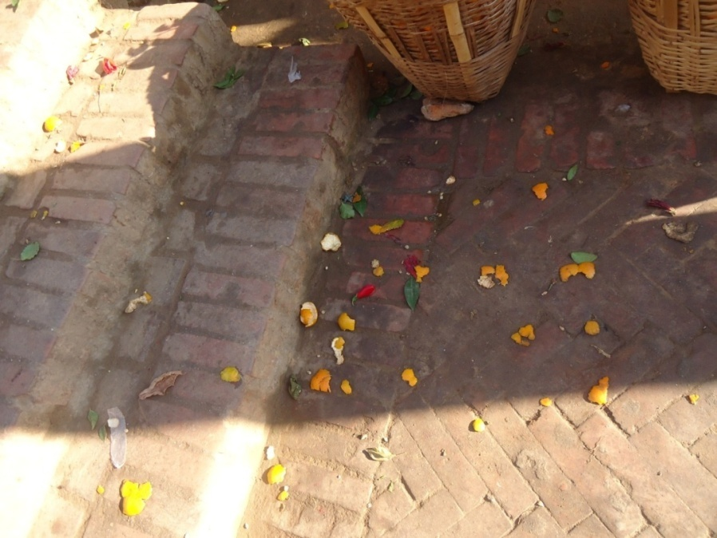
Thank You Very Much !
For any suggestions/comments
D. R. Pathak, PhD
Independent SWM Specialist
Engineering Study & Research Centre
Email: drpathak@esarcnepal.com

